Slide 1
AYSO National Referee Program
Player Development Initiatives:
2018 Referee Implementation
Notes:
Notes:
Purpose of workshop is two-fold:
Review PDI on-field implementation from the viewpoint of the referee administering it on the field
Collect comments/experiences from attendees after 1st year of implementation (round table format)
1

Slide 2
Purpose
Provide brief explanation of PDI including 2018 implementation update
Provide guidance to referees in how to administer matches impacted by the adoption of the PDI

Slide 3
PDI Focus On Player Development
Development over winning
Create environment for player success
Program uniform across US
Reduce advantage of strongest/fastest
Increase technical skills
Keep ball on ground

Slide 4
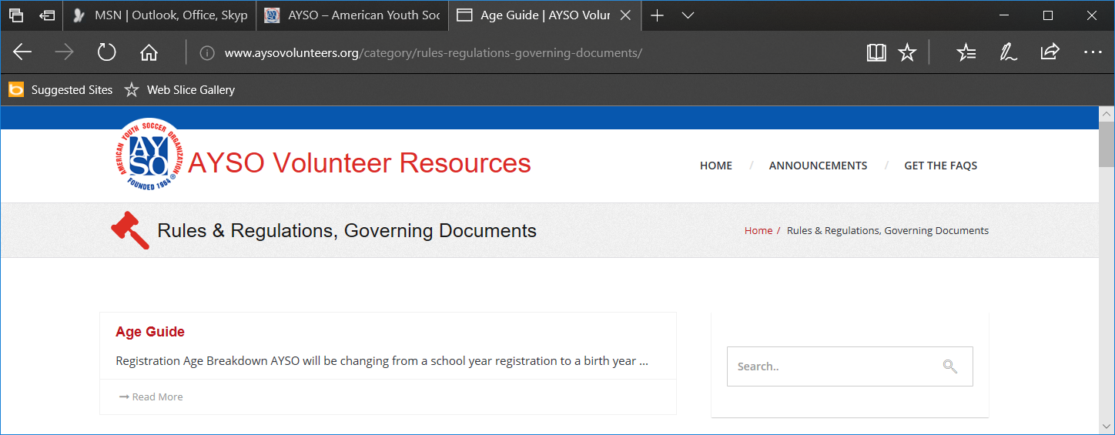
PDIs Captured In AYSO National Rules & Regulations*
Section I.
Part H. Small-sided matches
Part I. Heading the ball
Part J. Throw-ins (6U – 8U)
Part K. Goalkeeper punts (9U – 10U)
Part L. Build-out line (9U – 10U)
Updated for 2018
*2018 NR&R found at
www.ayso.org
Under
Volunteer Resources
Notes:
Instructor should have access to R&R electronic copy in case clarification is required
Hyperlink accesses copy in same folder – use only if appropriate.

Slide 5
PDI Impact on AYSO Game
Use small-sided games in 6U through 12U
AYSO has done this for several years
Modify 6U - 10U rules and field to promote build up of play and enhance technical skills
No deliberate heading of the ball by players in 11U and below (12U and below for programs without single age divisions)

Slide 6
Referee Implementation: “No Heading” Policy
Applies only to 11U and younger (12U and younger for programs without single age divisions)
If ball is deliberately headed then:
Referee stops play and reminds players of heading policy; also checks for potential injury
Play is restarted with IFK for opponent’s team at spot of infraction
If inside goal area then ball is moved to goal area line, parallel to goal line, nearest to the location of the infraction

Slide 7
Minor Impact on 6U – 8U
Throw-ins replaced by kick-in or dribble-in
Opponents must be at least 2 yards from ball until kicked
Goal may not be scored directly from kick-in or dribble-in
Throw-ins are optional (determined by the Region) at 8U
Goal may not be scored directly from throw-in

Slide 8
Impact on 9U-10U Matches
Goalkeeper punts (or drop kicks) are NOT allowed in 9U -10U
NOTE: Punts are now allowed in 11U – 12U
No deliberate heading of the ball
In addition 9U - 10U has Build-out Line (BOL) to promote development of technical skills
2018 NR&R

Slide 9
No Punts in 9U-10U
Per NR&R the goalkeeper in 9U-10U shall not deliberately punt or drop kick the ball
If goalkeeper punts the ball then play is stopped and an IFK is awarded to the opposing team at the spot the ball was punted (or drop kicked)
If inside the goal area, then the ball is moved to the goal area line parallel to the goal line at the point nearest to where the punt occurred

Slide 10
9U - 10U Build-Out Line (BOL)
9U -10U matches now include BOL to help promote development of player skills
BOL only impacts these three situations:
Goalkeeper releasing ball after gaining possession in hands
Goal Kicks
Offside

Slide 11
9U – 10U Build-Out Line (BOL)
halfway
halfway
Build-Out Lines
60 x 40 10U Field

Slide 12
9U - 10U Build-Out Line
Located halfway between the halfway line and penalty area line parallel to the goal line
Line may be solid, dashed, or simply marked by cones (or flags) off the field
Referee needs to know how line is marked prior to match
Good practice to remind players/coaches prior to match

Slide 13
Build-Out Line Basic Concepts
Promotes development of skills by:
Providing additional space and time for a team to build an attack after a save by a goalkeeper or from a goal kick
Allows attacking team more room to develop attack by:
Having the BOL replace the halfway line in the judgement of offside infractions

Slide 14
BOL Does Not Restrict Player Location During Normal Play
Blue
OK in regular
game play

Slide 15
Opponents MUST Move Behind BOL When GK Gets Possession
Blue
Ball in GK
Hands

Slide 16
BOL and Goalkeeper Possession
Per NR&R: When goalkeeper gains possession of ball with hands
Opponents must retreat behind BOL
Opponents may cross BOL once the ball is released from goalkeeper’s hands
Goalkeeper has option to release ball without waiting for opponents to retreat
Opponents then may not be penalized for not retreating across the BOL

Slide 17
What about other saves by Goalkeeper? (9U - 10U)
If goalkeeper kicks/punches ball rather than trying to collect ball with hands, then play continues as usual
BOL is not a factor

Slide 18
Goalkeeper Possession: Referee Considerations
2018 NR&R
Goalkeeper may release ball to either side of BOL
BOL only impacts opposing team position on field
Goalkeeper does not need to wait for opponents to retreat; takes risk of interception
Referee should encourage opponents to retreat
Goalkeeper has “6-seconds” to release ball from hands after opponents have retreated across BOL (not commonly enforced in 9U/10U – vocally encourage goalkeeper to release ball)
If ball goes directly out of play then restart with TI or CK as appropriate per LOTG

Slide 19
Goalkeeper Possession: Opponent Considerations
Opponents may cross the BOL as soon as the ball is released from the goalkeeper’s hands
Infraction: opponent crosses BOL before goalkeeper releases ball and subsequently interferes with play
Be vocally proactive; manage opponents to avoid this behavior
Use judgement and don’t interfere for trifling infraction
If play has to be stopped to deal with infraction
Remind opponents of proper procedure
Restart with IFK for goalkeeper’s team on BOL where infraction occurred
New 2018 Instruction

Slide 20
Opponents MUST Move Behind BOL for Goal Kick
Blue

Slide 21
Restarting Play From Goal Kick
Per NR&R: Opponents must move behind BOL when play is restarted with a goal kick.
Player taking goal kick does not need to wait for opponents to retreat across the BOL
Ball may be kicked to either side of BOL
Opponents may cross BOL when ball is in play per Law 16 (ball exits penalty area)
2018 NR&R

Slide 22
Goal Kick: Referee Management
Referee should encourage opponents to retreat
Player taking goal kick does not need to wait for opponents to retreat
Kicker takes risk of interception
Opponents then may not be penalized for not retreating across the BOL
Ball may be kicked to any point on the field
If ball is kicked directly out of play then restart with TI or CK as appropriate per LOTG

Slide 23
Goal Kick: Opponent Considerations
2018 NR&R
Opponents may cross BOL as soon as ball exits penalty area (“in play” per Law 16)
Infraction: Opponents cross BOL before kick is taken or before ball exits penalty area
Referee stops play; asks opponents to retreat, then Goal Kick is retaken
Use judgement and don’t interfere for trifling infraction
Be vocally proactive; manage opponents to avoid this behavior

Slide 24
BOL Limits Location of Offside Position
Attacking
Possible offside area
for 9U – 10U
No longer can be offside in 9U – 10U

Slide 25
BOL and Offside
For the attacking team, the area of potential offside infractions is bounded by the BOL in the opponent’s half of the field and the opponent’s goal line.
That BOL replaces the Halfway Line as the boundary where offside infractions are considered
The Assistant Referee movement along the touchline is then limited by that BOL and the associated goal line

Slide 26
BOL Defines Potential Offside Infractions
NOT in offside
position
Attacking

Slide 27
BOL Defines Potential Offside Infractions
In offside
position
Attacking

Slide 28
Apply AYSO Team Concept
Work with coaches to address repeated infractions of the PDI
Repeated infractions should NOT be considered as part of Persistent Offenses misconduct
Notes:
Emphasize working with coaches to manage players. Infractions of PDI rules are NOT to considered as any form of Persistent Offenses per Law 12!

Slide 29
Summary: Key Points
Punts NOT allowed in 9U - 10U
Punts are now allowed in 11U-12U
Build-Out Line used in 9U -10U
Impacts offside, goal kicks, goalkeeper possession in hands
Be aware that AYSO implementation may differ from other organizations
Know the rules of competition
Notes:
Summary of key points

Slide 30
Acknowledgements
We wish to thank Rich McGuire (10/E/4) and Martin Bittner (SDI 2) for much of the graphical content

